Slide 1
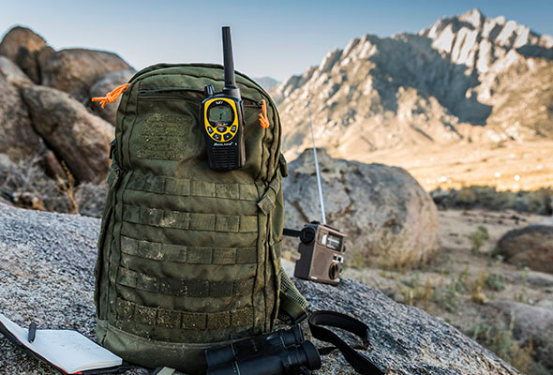
Taking ACT Tactical: Inside a trainers “go bag”
Chinese finger traps
Clickers
Deck of cards
Duct tap
Dry and wet erase markers
Personal gear
Head lamp
Hiking gear
Weather gear
Sunscreen and Bug Repellent
Water Source and nonperishable snacks
Flash cards
Flip chart paper and sharpies
Sheet protectors
Small white boards
Ten by twenty tarp
Timers
Toy cars

